Slide 1
Group 9 Demo Outline
Xuanyu Zhao a1655611
Yawen Luo a1657343
Wei Zhang a1657881
Supervisor: Sergey Polyakovskiy

Slide 2
2L-HFVRP
Two Frames
1.Main Frame
2.Result Frame

Slide 3
Advantages:
GUI:
Brief appearance
Easy to understand
Functionality:
15 items to 786 items
15 customers to 255 customers
Operability:
Easy to operate

Slide 4
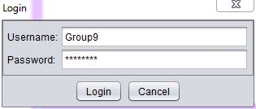
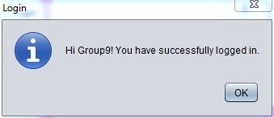
1.Main Frame
Log in

Slide 5
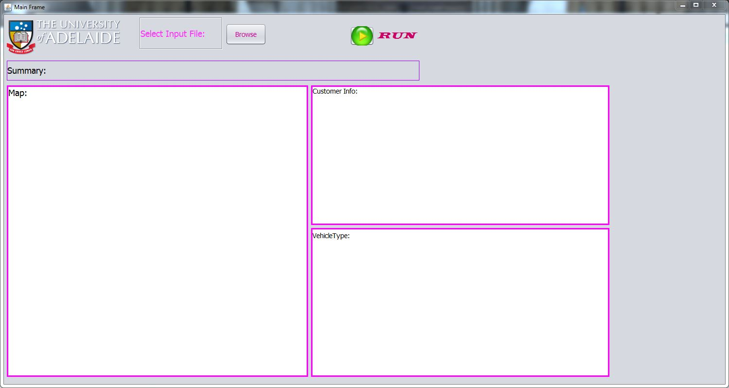
1.Main Frame
Open Software

Slide 6
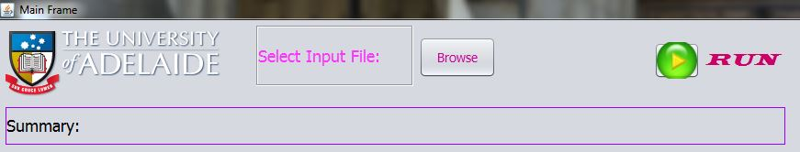
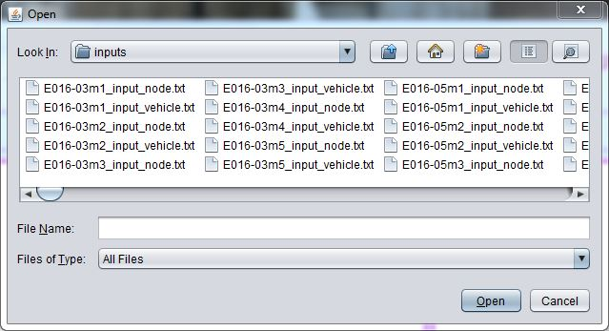
1.Main Frame
Select Input File

Slide 7
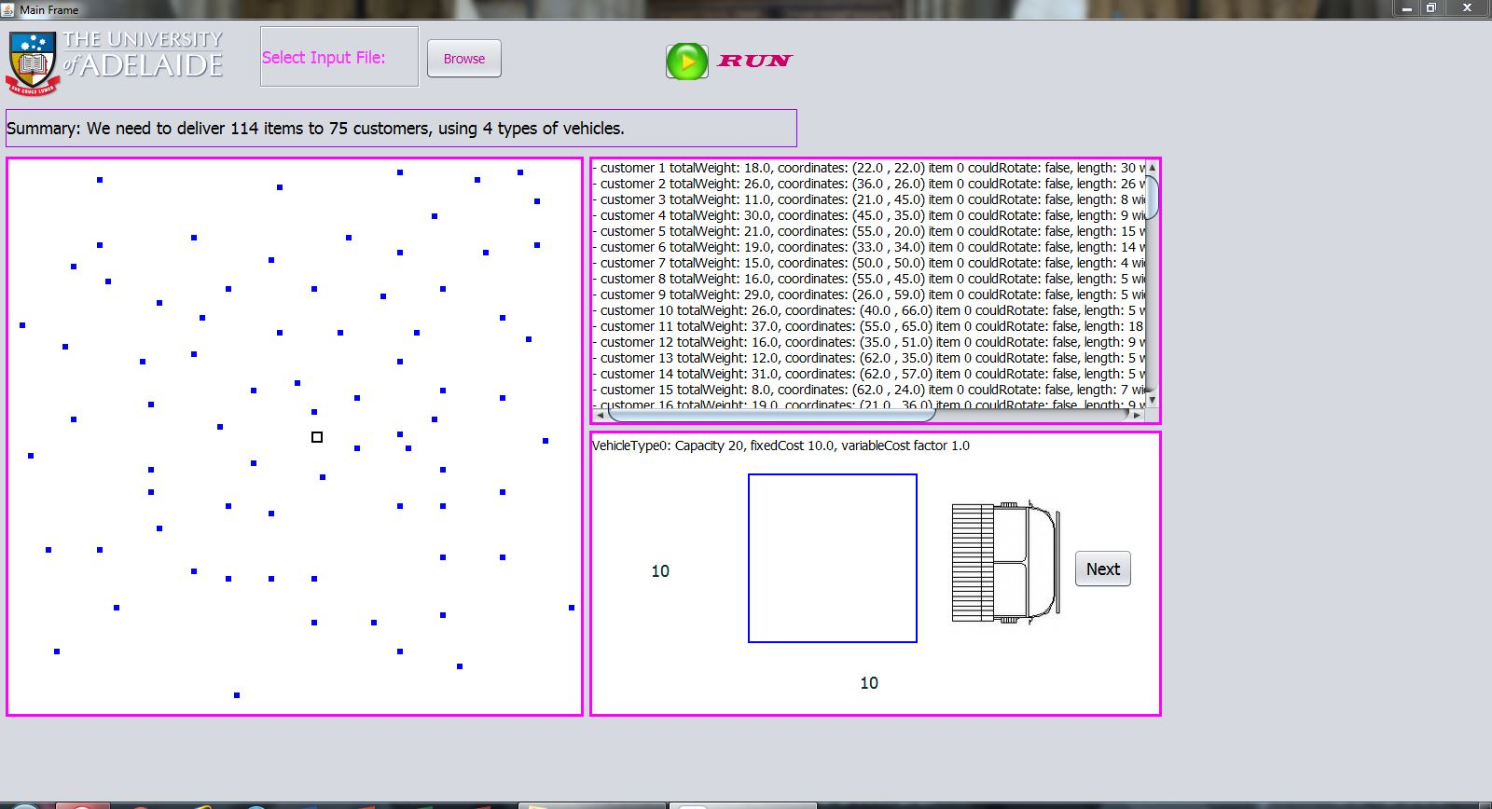
1.Main Frame
Input file

Slide 8
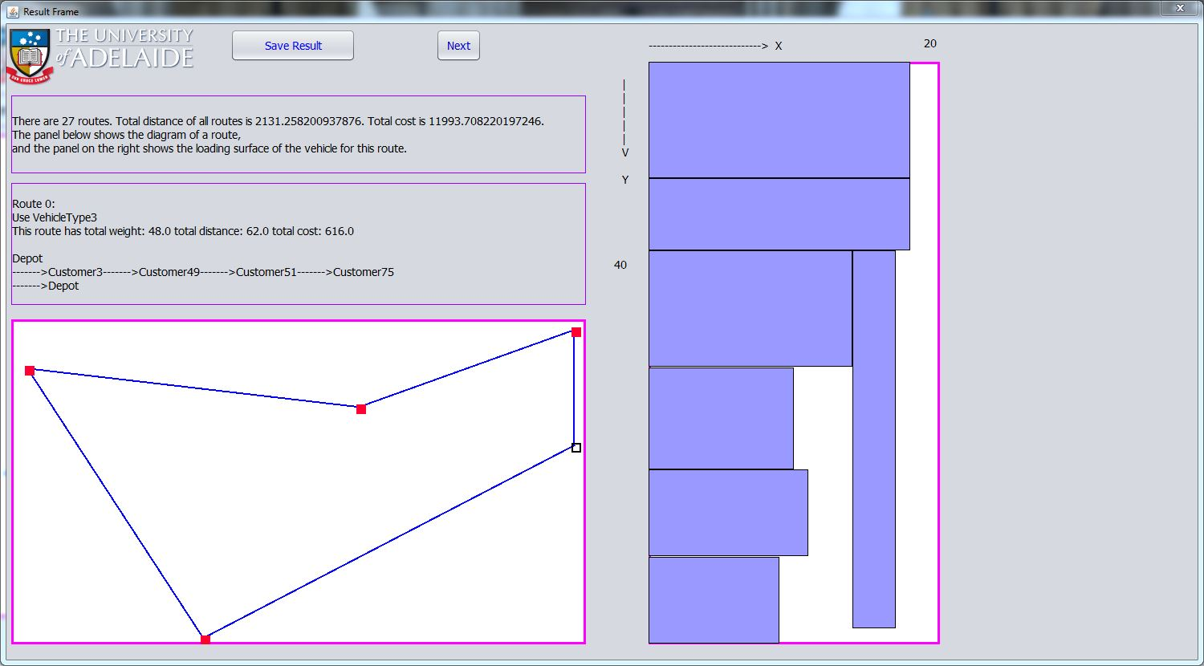
2.Result Frame
Run

Slide 9
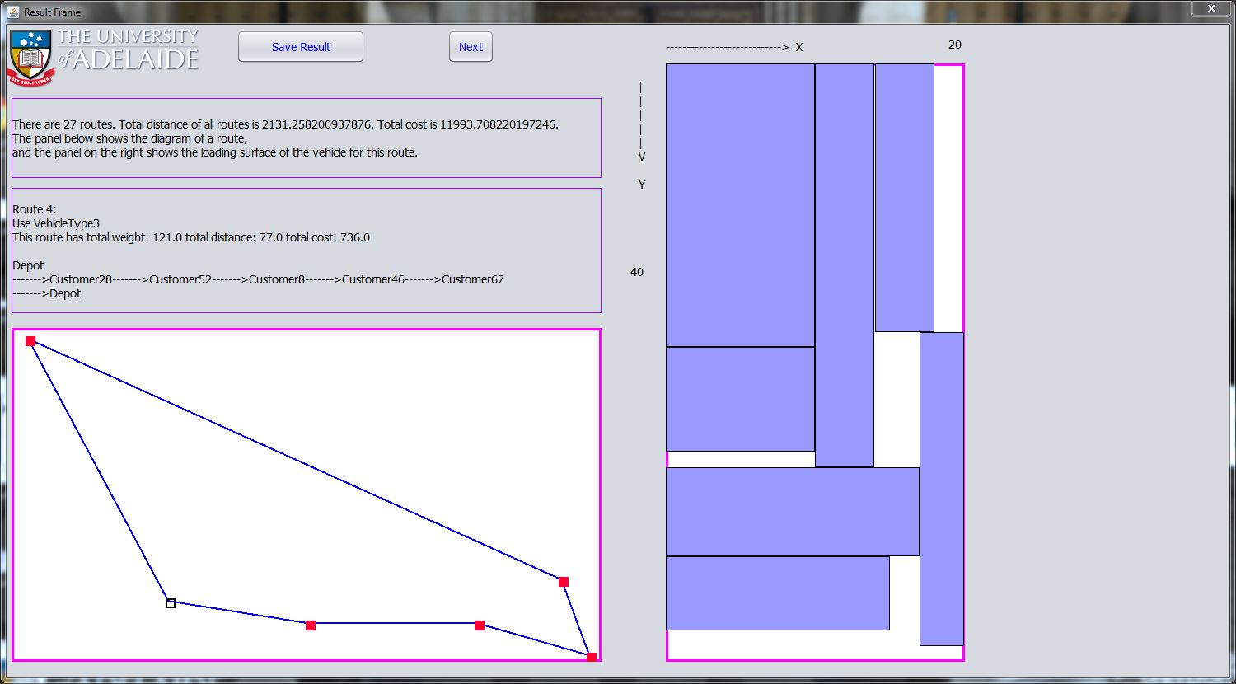
2.Result Frame
Next Route

Slide 10
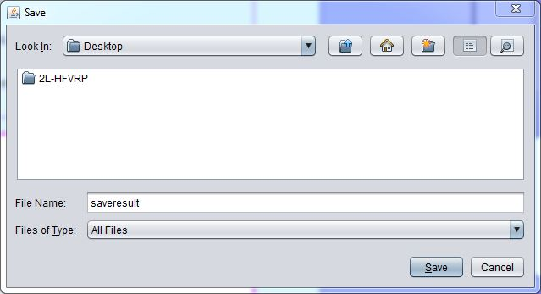
2.Result Frame
Save result

Slide 11
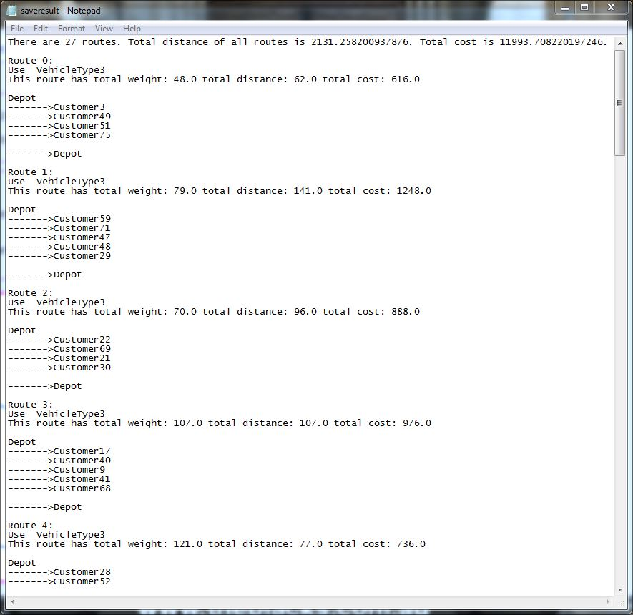
2.Result Frame
Save result

